Slide 1

Traffic Sign Recognition for better performance in self driving cars using Deep Learning Techniques
MAJOR PROJECT

Slide 2

MEMBERS OF THIS PROJECT
Sharika Anjum Mondal
Prithivi Guha
Koustav Pal

Slide 3

CONTENTS
Abstract
Introduction
Workflow – 1
Model Evaluation
Workflow – 2
Results
Limitations
Applications
Future Work
Conclusion
This Photo by Unknown Author is licensed under CC BY

Slide 4

The traffic sign recognition system (TSRS) is an important component of an intelligent transportation system (ITS). Being able to interpret traffic signs properly and efficiently can increase driving safety. This project proposes a traffic sign identification approach based on deep learning, which primarily targets at the detection and classification of traffic signs while being trained on a traffic sign benchmark dataset. A traffic sign recognition and identification approach based on image processing is proposed, which is integrated with a convolutional neural network (CNN) to classify traffic signs. TensorFlow is utilized to implement CNN. We have 99.4% accuracy in identifying.
ABSTRACT

Slide 5

INTRODUCTION

Slide 6

DATA COLLECTION
Benchmark dataset in traffic sign recognition – GTSRB
The dataset contains more than 50,000 images of different traffic signs.
It is further classified into 43 different classes.
It is quite varying, some of the classes have many images while some classes have few images.
The size of the dataset is around 300 MB.
The dataset has a train folder which contains images inside each class.
A test folder which we will use for blind testing our model.

Slide 7
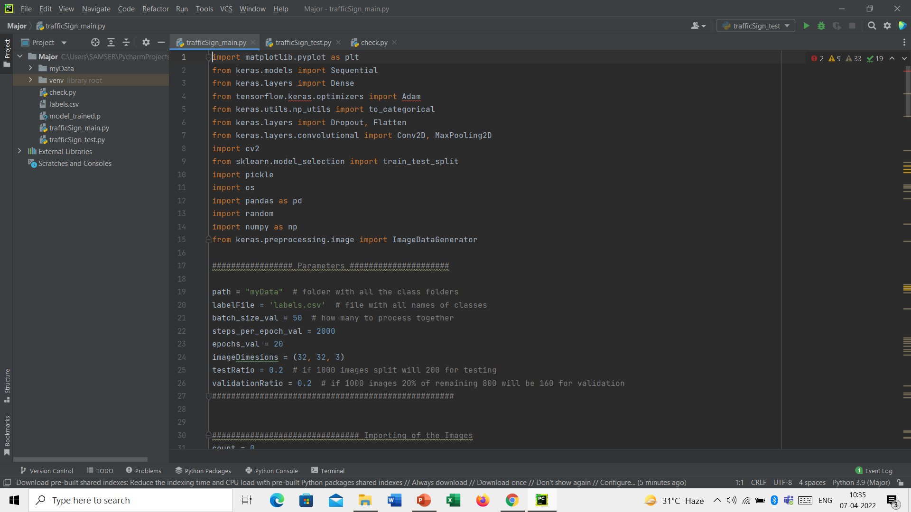
IMPORTING THE PRE-REQUISITES

Slide 8

IMPORTING THE IMAGES AND IMAGE PROCESSING

Slide 9

IMPORTING THE IMAGES AND IMAGE PROCESSING

Slide 10

IMPORTING THE IMAGES AND IMAGE PROCESSING

Slide 11
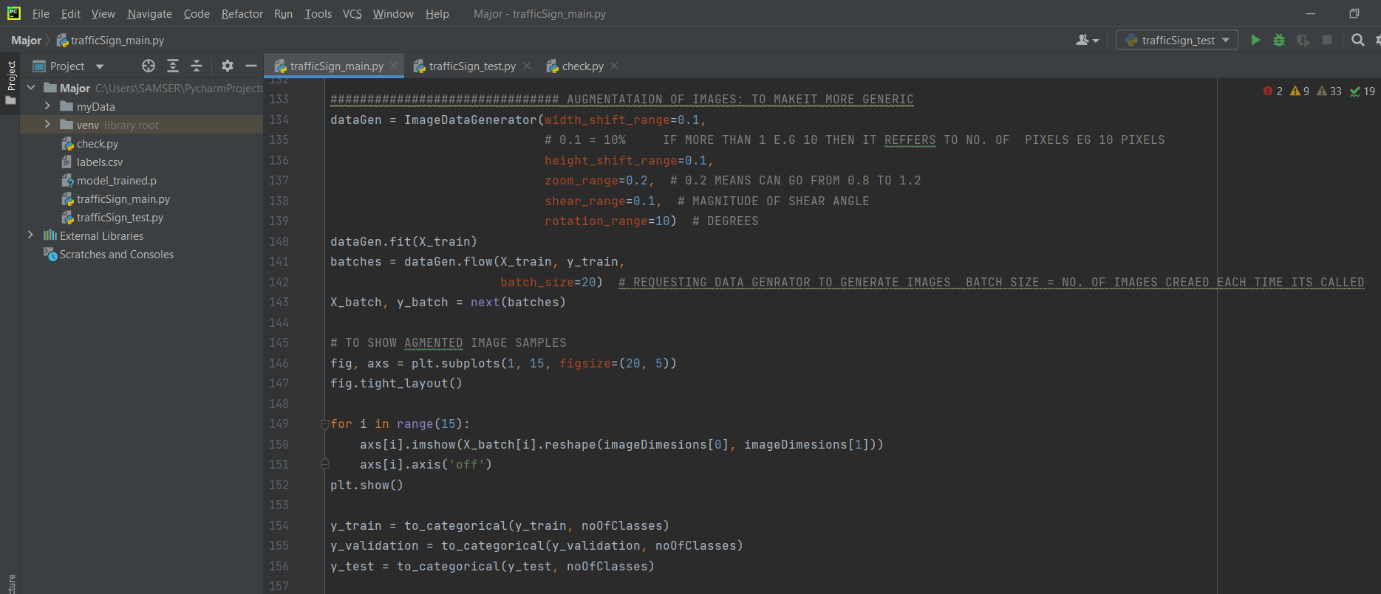
IMAGE AUGMENTATION

Slide 12

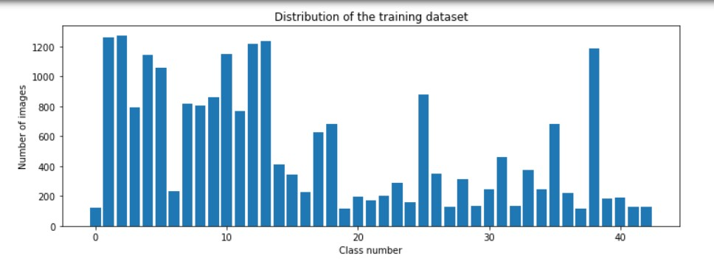
DATA VISUALIZATION

Slide 13
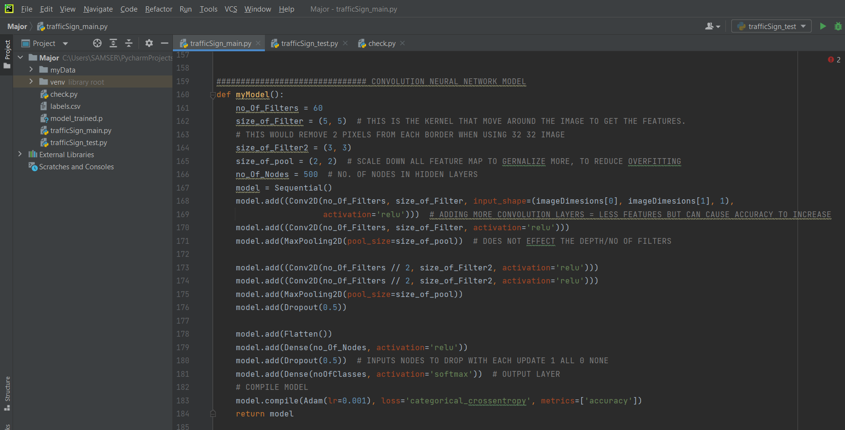
MODEL BUILDING

Slide 14
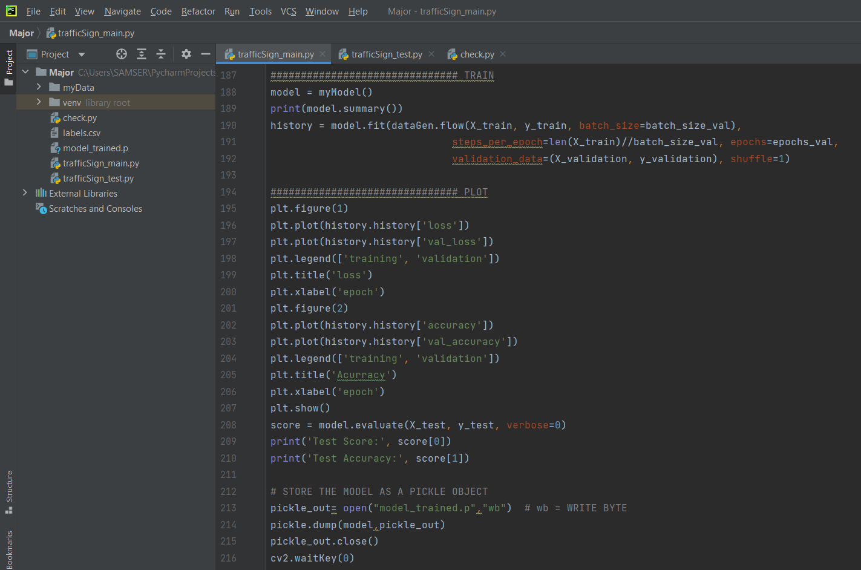
TRAINING
Training time = 5hrs 30mins approx.

Slide 15

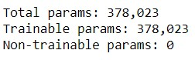

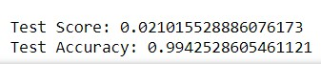
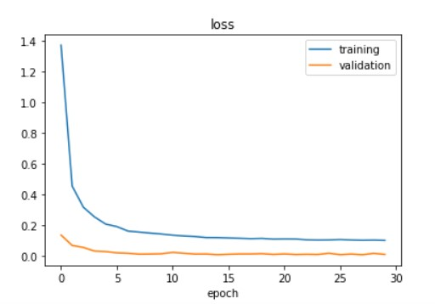
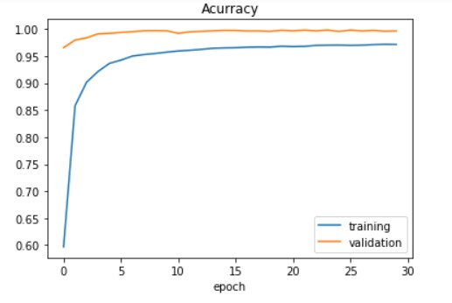
MODEL EVALUATION

Slide 16
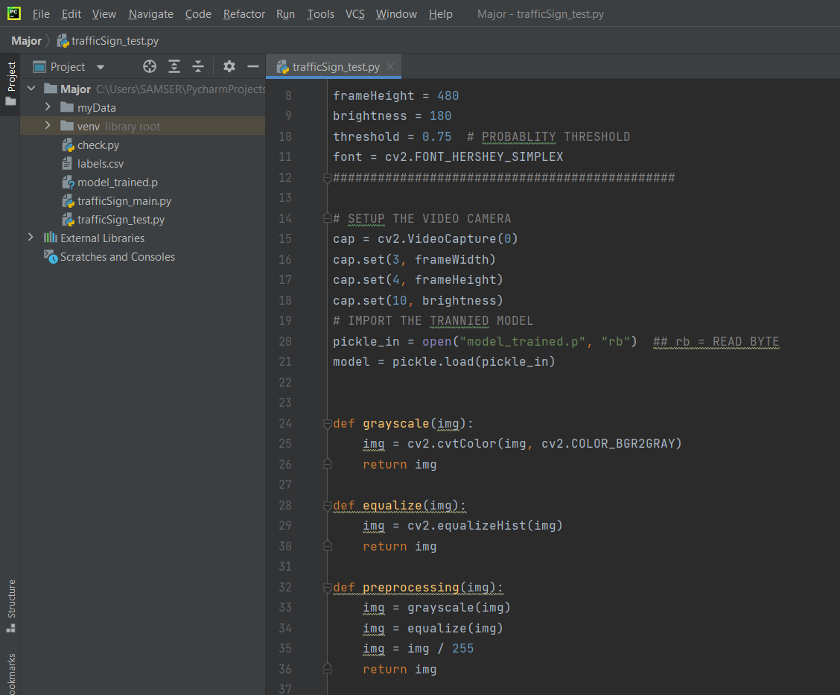
SETTING THE WEB CAM & TESTING

Slide 17
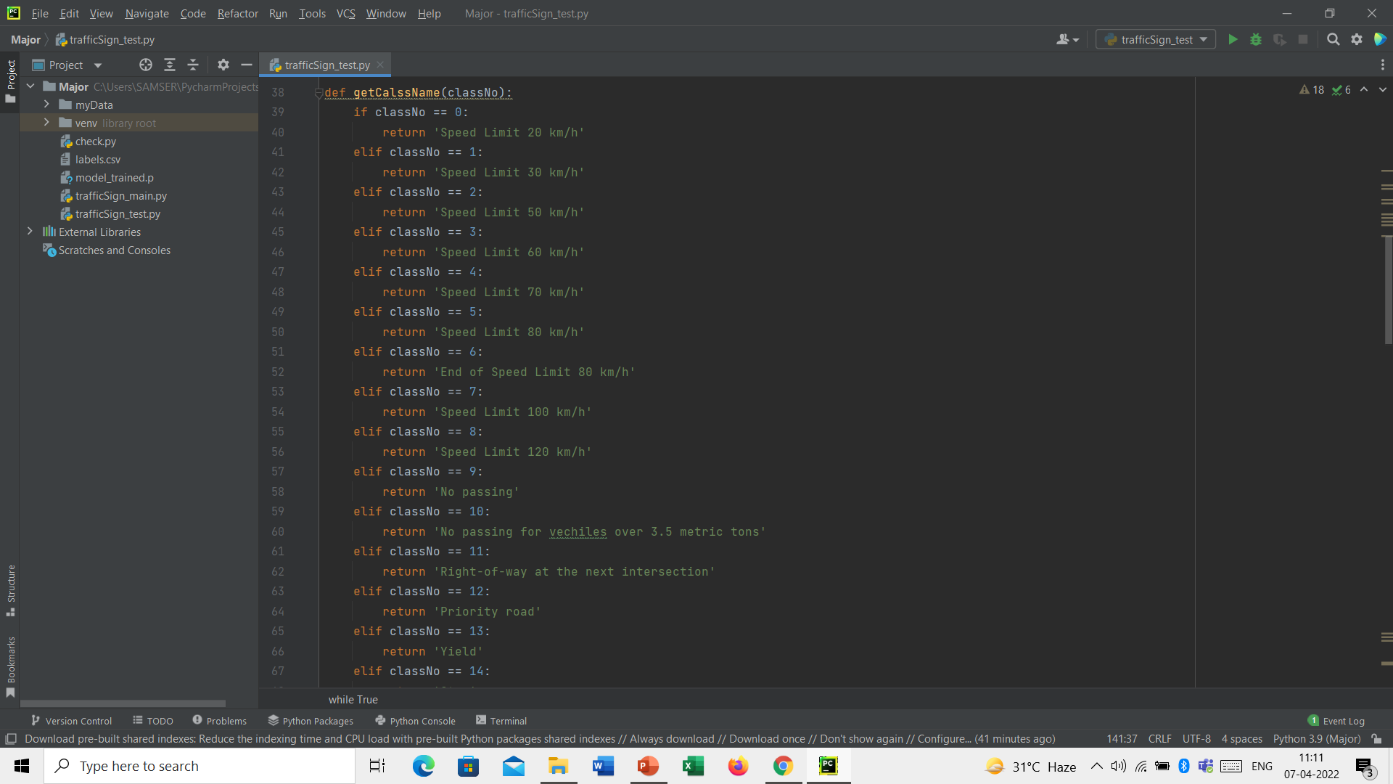
SETTING THE WEB CAM & TESTING

Slide 18
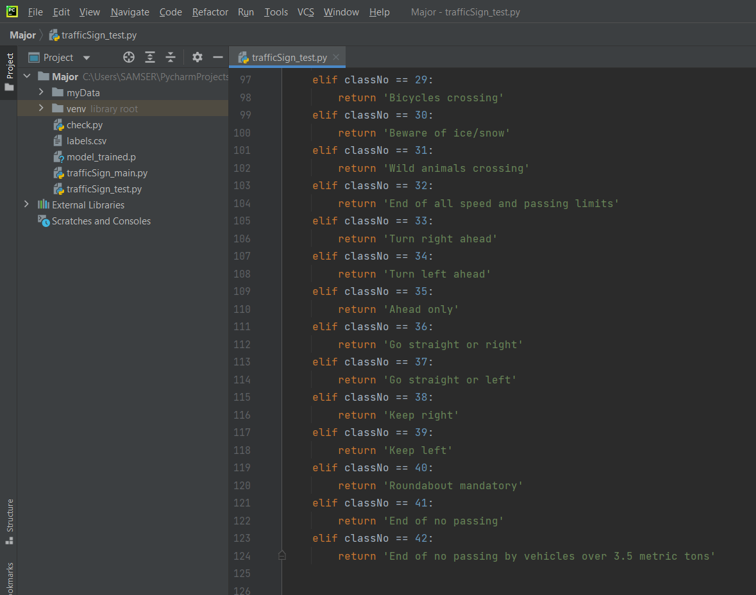
SETTING THE WEB CAM & TESTING

Slide 19
SETTING THE WEB CAM & TESTING

Slide 20
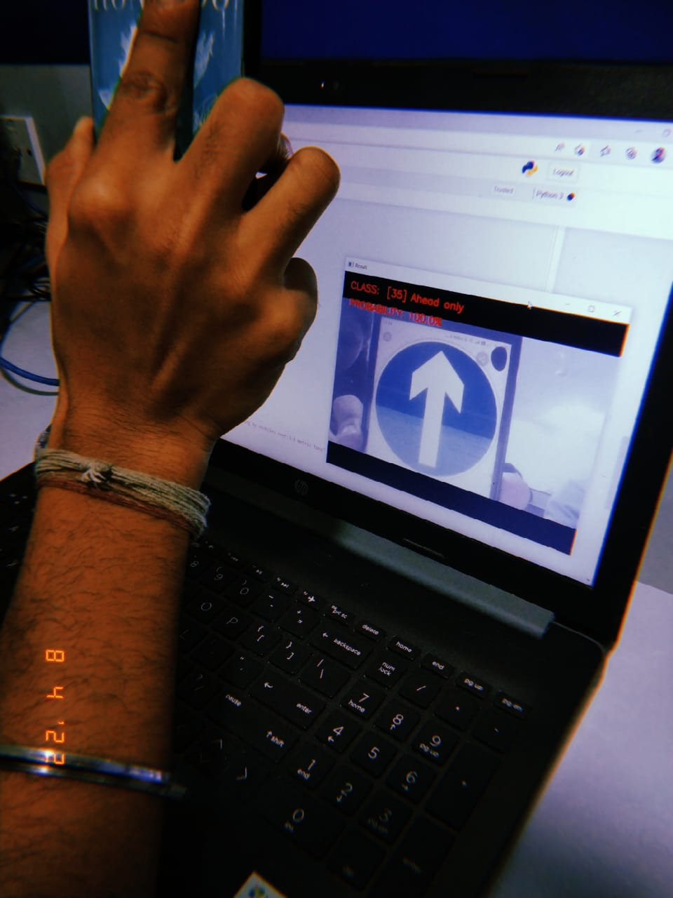
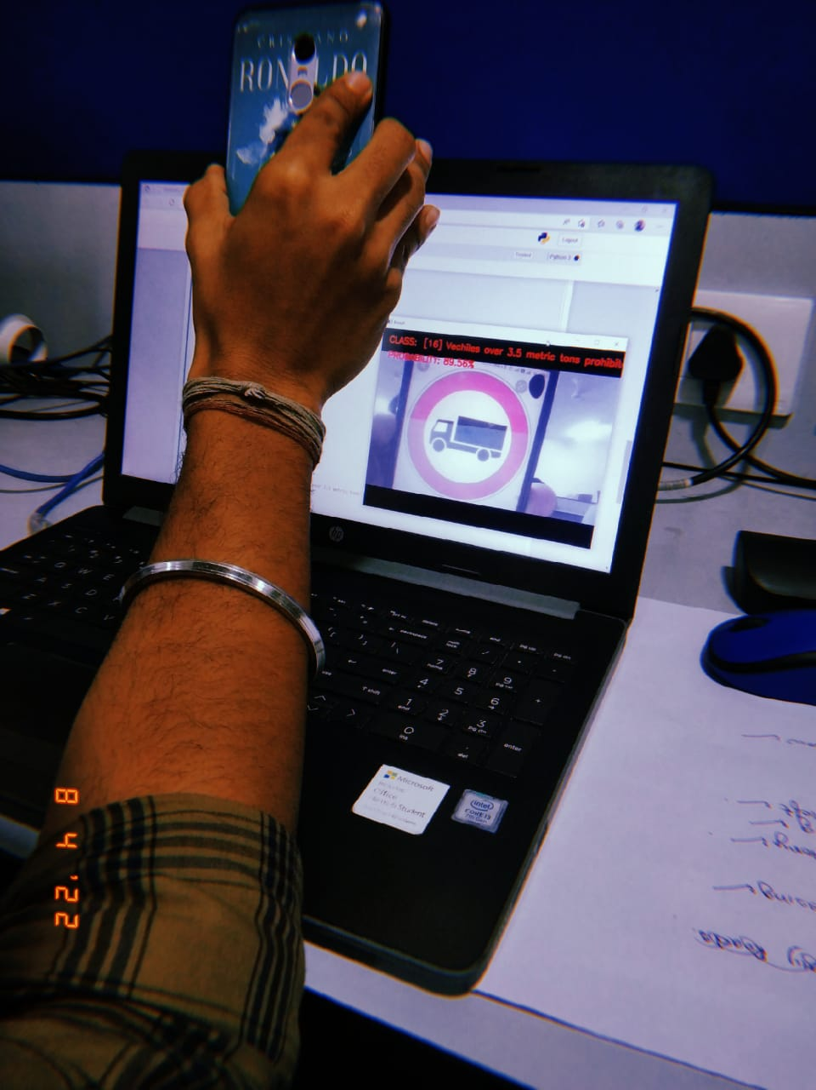
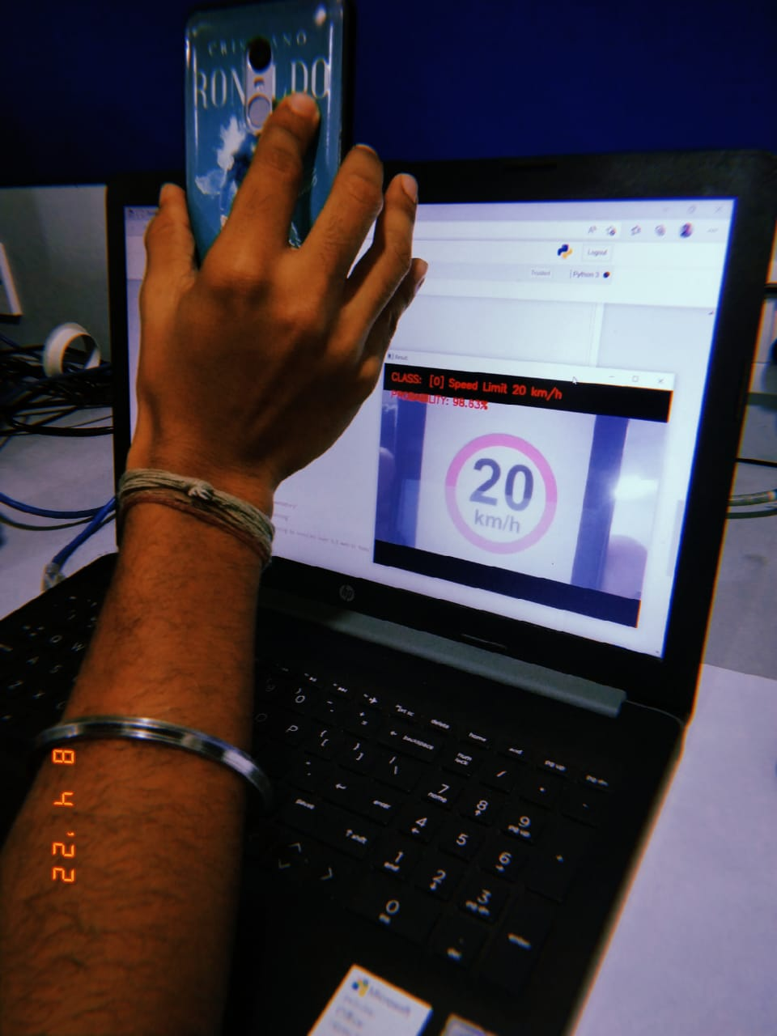
RESULTS
Detected class – Ahead only
Accuracy – 100%
Detected class – Vehicles over 3.5 metric tones prohibited
Accuracy – 89.56%
Detected class – Speed limit 20km/h
Accuracy – 98.63%

Slide 21

LIMITATIONS
The computational time and cost required is enormous. To train the model quicker, enough resources are required. Our model took 2 hours to train in one device and almost 5 hours to train in another.
The model fails to capture pose, view, orientation of the images because of the intrinsic inability of max pooling layer.
Huge amount of data required to train the model.
Image processing should be done properly to detect and focus the sign boards properly and to read the images which are hazy.

Slide 22

APPLICATIONS
Provide drivers with traffic sign information, and regulate driver operations in all vehicles if installed.
Helpful for self-driving cars.
Helpful for people inside the car with visual impairment as it is an audio enabled system.
Ensures road safety.

Slide 23

Future Work
The model fails to capture pose, view, orientation of the images because of the intrinsic inability of max pooling layer, so this area needs to be worked on.
Better training required.
Good resources required - The computational time and cost required is enormous. To train the model quicker, enough resources are required. Our model took 2 hours to train in one device and almost 5 hours to train in another.
Image processing should be done properly and also a good IP camera required to detect and focus the sign boards properly and to read the images which are hazy.

Slide 24

This project considers a classification algorithm implementation for the traffic sign recognition problem. The suggested approach for traffic sign classification, when combined with image processing stages, yields extremely good results: 99.4 percent of correctly identified photos. The TensorFlow framework is used to implement the proposed classification method. The created approach was tested on a device equipped with an Intel Core i3 7th Gen Processor. In future, we intend to train the CNN to take into account more traffic sign classifications as well as probable severe weather circumstances.

Slide 25


